Slide 1
Chapter 8
A New Nation
Section 1: Washington Leads a New Nation
Section 2: Hamilton & National Finances
Section 3: Challenges for a New Nation
Section 4: John Adams’s Presidency

Slide 2
Ch7 Section 1:
Washington Leads a New Nation

Slide 4
A NEW GOVERNMENT
In 1789 each of the states that passed the Constitution sent electors to choose the first president
ELECTORAL COLLEGE: a group of electors that represent the people’s vote for president
Washington was elected unanimously, and John Adams became his Vice President

Slide 5
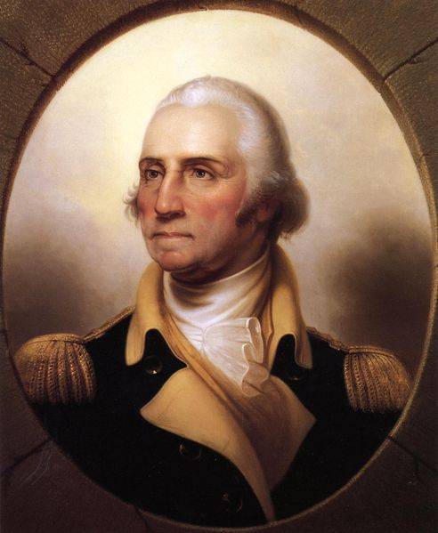
George Washinton
Washington was hoping to retire, but was convinced that he was the best fit for president
He Was “Mr. President”
He set many Precedents:
  an action or decision that later serves as an example
Notes:
Washington was escorted from town to town
Crowds cheered and church bells rang
Congress spent a month debating on what to call the president – “Mr. President”
Washington appeared on national coins

Slide 6
George Washington taking the 1st Presidential Oath of Office

Slide 7
Executive Branch
Three Departments in Executive Branch
  Department Treasury – financial matters
  Department of State – foreign affairs
  Department of Defense – national defense
Office of the Attorney General was created to handle national legal matters.
The CABINET: Group of advisors to the President made up of three department heads (Secretaries) and the Attorney General
Notes:
Members of the new government had to create new policies that would determine the future of the country
Washington wrote: “The first of everything in our situation will serve to establish a precedent.”

Slide 8
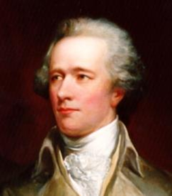
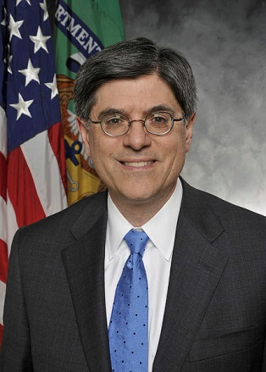
Secretary of Treasury
Financial Matters
Alexander Hamilton
1789-1795
1st Secretary
Jacob Lew
2013- present
76th Secretary

Slide 9
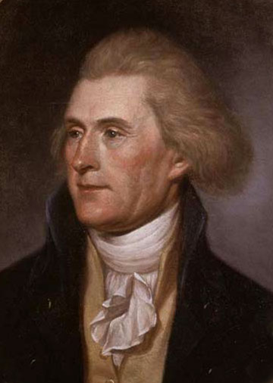
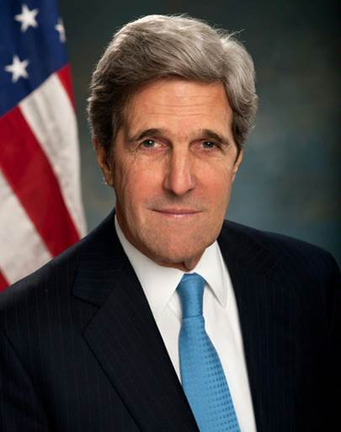
Secretary of State foreign relations
Thomas Jefferson
1790-1793
1st Secretary
John Kerry
2013-Present
68th Secretary

Slide 10
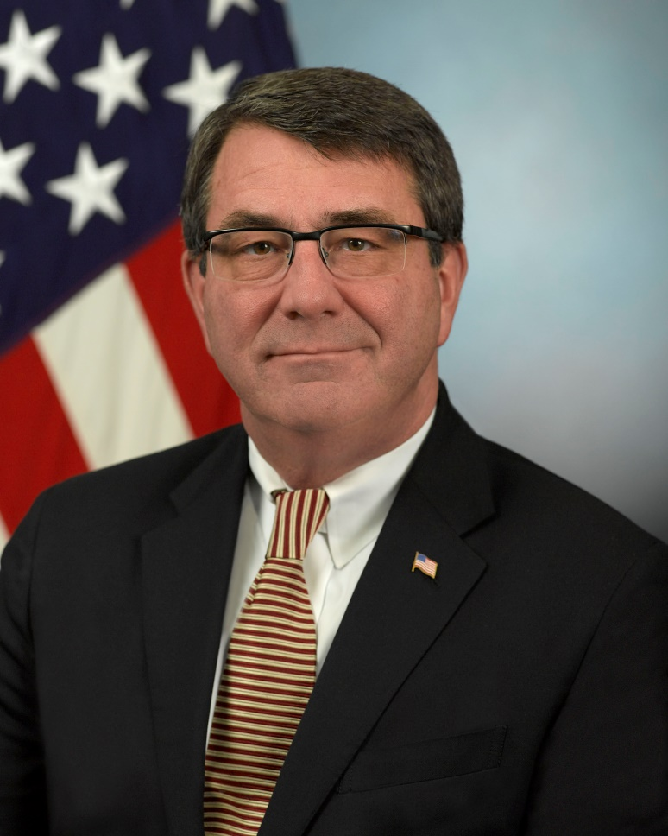
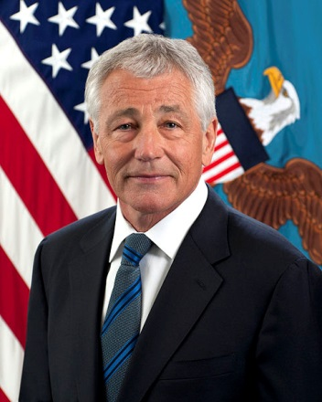
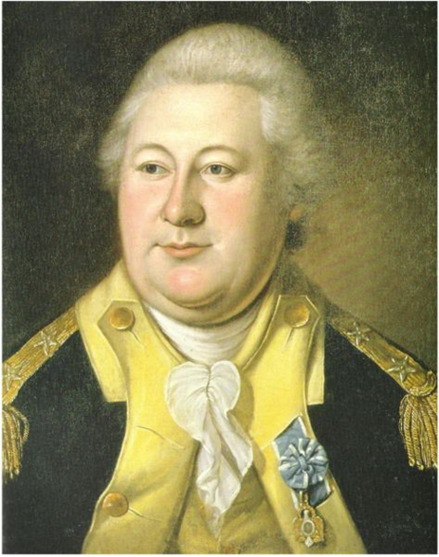
Secretary of Defense National Defense
Henry Knox
1789-1794
1st Secretary
Ashton Carter
2015-present
25th Secretary
NOMINEE
Ashton Carter
25th Secretary?.
Chuck Hagel
2013-present
24th Secretary

Slide 11
JUDICIARY ACT OF 1789
Congress set up the federal court system
It established a Supreme Court with 6 judges
13 district courts and 3 courts of appeal
State Laws remained but Federal courts have the power to reverse state decisions
President nominated judges, then they had to be approved by the senate
John Jay – 1st Supreme Court Justice

Slide 12
Ch7 Section 2:
Hamilton & National Finances
Hamilton schools Jefferson on the National Bank

Slide 13
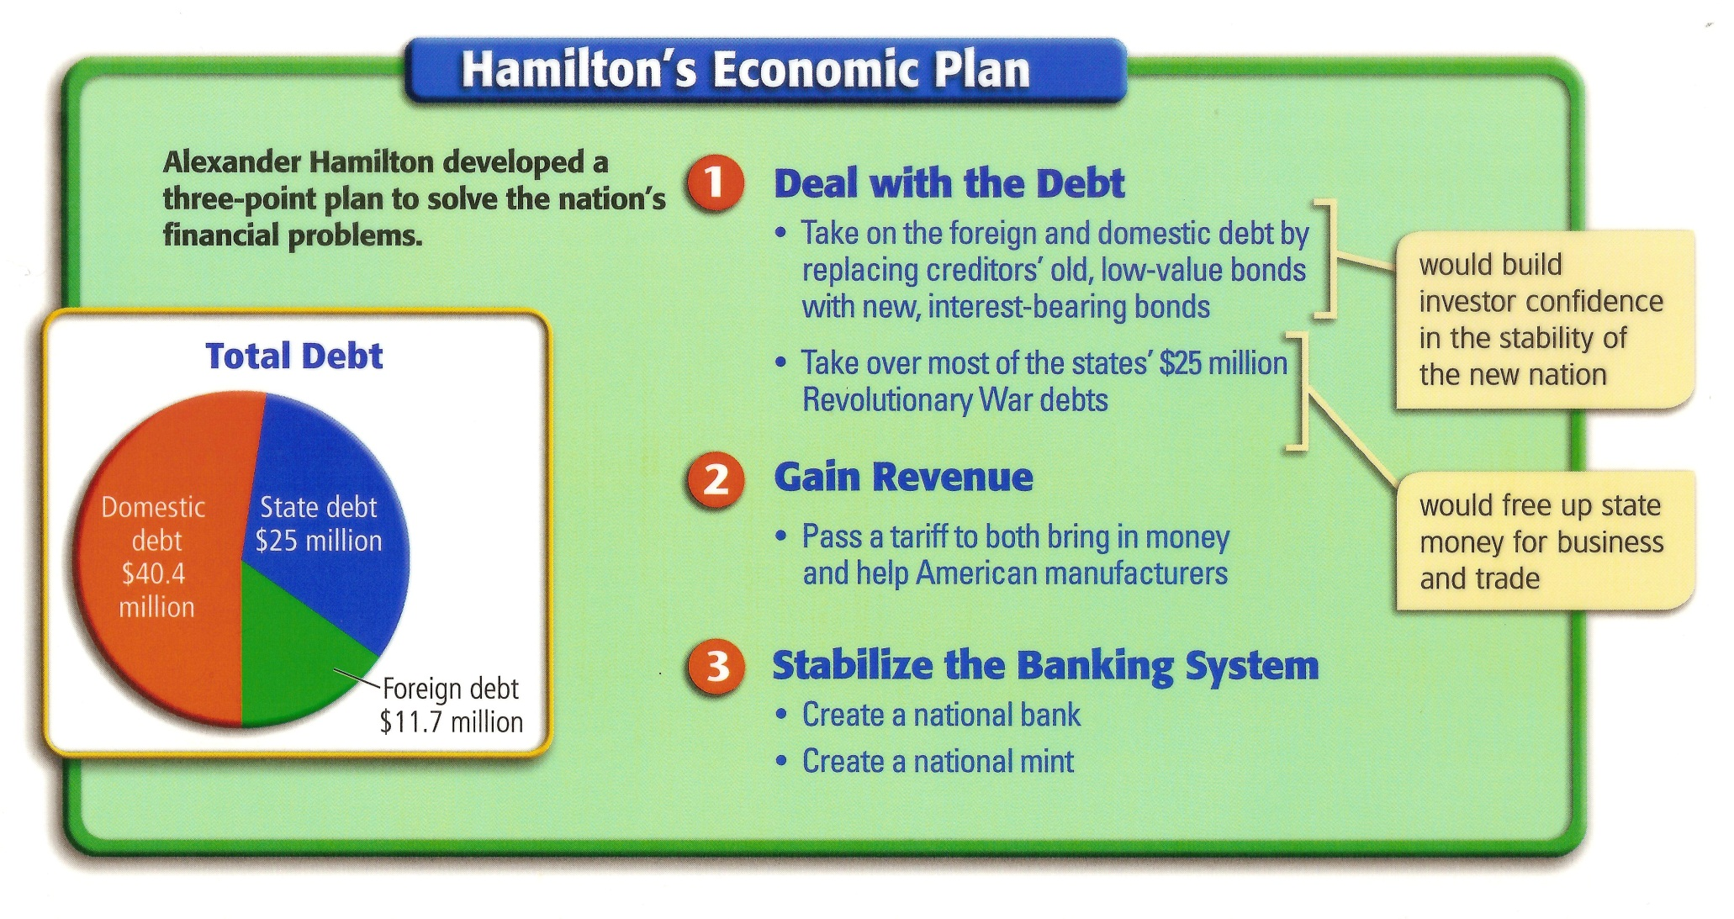
Sec. of Treasury, Hamilton had to deal with a huge debt
NATIONAL DEBT: The amount of money owed by the U.S.
US National Debt Clock
Notes:
Paying off bonds: controversial
Some fair (Hamilton)—speculators took the risk
Some unfair—Jefferson—they had sold their bonds for pennies on the dollar
Hamilton won
STATE Debts
Hamilton—this would help the national economy.
Debtor states could use that money to help start businesses.
South against this—VA and SC did not have many war debts.
Patrick Henry—didn’t believe paying them was constitutional.

Slide 14
HAMILTON’S ECONOMIC PLAN
Hamilton wanted to pay down US debt, place tariffs on imports and create a national bank.
He proposed that the government take on the entire debt of the federal government and the states
His plan was to pay off old debt by borrowing new money at a lower interest rate.

Slide 15
ECONOMIC PROBLEMS:
The debt fell into 3 categories
Foreign Countries: Owed $11.7 million (mostly to France)
U. S. Citizens: Owed $40.4 million (Bonds)
States: Owed $25 million (food, weapons, etc.)

Slide 16
Hamilton’s 3 Point Plan
DEAL WITH THE DEBT: Pay foreign debt first. Gradually pay off bonds. Pay state debt
GAIN REVENUE: Raising protective tariffs would increase prices of foreign products, causing Americans to buy more US goods
STABILIZE THE BANKING SYSTEM: create a national bank and a national mint

Slide 17
NATIONAL DEBT
Congress could not agree on how to pay the debt to American citizens
Bonds were issued during the war, and promised to be repaid in a given amount of time
BONDS: Certificates of debt that carry a promise to buy them back at a higher price
Speculators bought the bonds at a cheaper price
Hamilton wanted to pay off the bonds at the original price, making speculators rich
Jefferson opposed Hamilton, unfair to original bondholders
Notes:
States like Maryland, Pennsylvania, North Carolina, and Virginia, which had already paid off their debts, saw no reason why they should be taxed by the federal government to pay off the debts of other states like Massachusetts and South Carolina.
Hamilton's critics claimed that his scheme would provide enormous profits to speculators who had bought bonds from Revolutionary War veterans for as little as 10 or 15 cents on the dollar.
For six months, a bitter debate raged in Congress, until James Madison and Thomas Jefferson engineered a compromise.
In exchange for southern votes, Hamilton promised to support locating the national capital on the banks of the Potomac River, the border between two southern states, Virginia and Maryland.
*****************************************************
Hamilton knows he needs southern reps to get his plan approved.
Hamilton promised to move capital to the south.
Southerners felt that the capital being in NYC gave the North too much influence over national policy.
1791 capital is moved from NYC to Philly for 10 years.
George Washington chose the spot for DC…between Maryland and VA for permanent capital.
********************************************************
Bonds: certificates of debt that carry a promise to buy back bonds at a higher price. BUT…could not
Speculators: people who buy items at low prices in hopes of selling them for a profit.
Hamilton replaced the old bonds with new interest bearing bonds.
Jefferson felt this was NOT fair to those who had sold their bonds to speculators.
States owed $25 million
Hamilton suggests federal govt. pays $21.5 million.
Some states upset because they have very little debt.

Slide 18
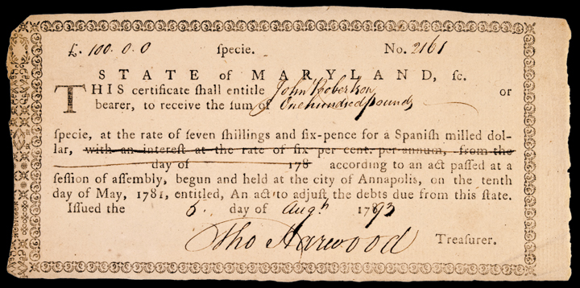
Revolutionary War Bond

Slide 19
States’ Debts
States owed $25 million
Hamilton suggests federal govt. pays $21.5 million.
Some states upset because they have very little debt.
Southern states had little debt and opposed Hamilton’s plan
Notes:
keep

Slide 20
Moving the Capital
Jefferson and Madison urged the Southern States to compromise
For acceptance of the plan, the new capitol of the United States would be permanently moved from New York to a site on the Potomac River
If left in New York or Philadelphia, political and economic power might be in the North

Slide 21
Jefferson opposes Hamilton
HAMILTON’S VIEWS
JEFFERSON’S VIEWS
Believed in a strong central government.
Wanted a balance of power between the “mass of people” and wealthier citizens.
Wanted to promote manufacturing and business.
Wanted higher tariffs on foreign goods to protect American manufacturers.
Wanted to protect the states power.
Believed in the right of “the people” to rule the country.
Supported agriculture and farmers.
Wanted lower tariffs to keep costs low for goods farmers bought.

Slide 22
Hamilton’s Plan for a National Bank
Hamilton wanted to create a national bank
  Government has safe place to keep its money
  Make loans to gvt & businesses
  National mint to make coin & paper money
Washington signed the bill to create the bank for a term of 20 years
States were charged with creating state banks
Notes:
keep

Slide 23
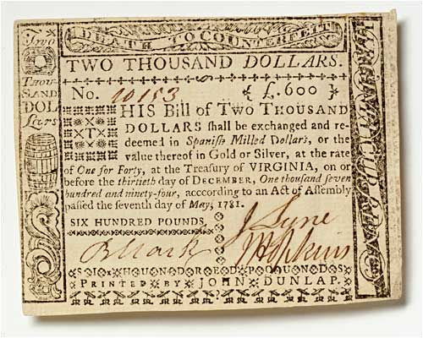
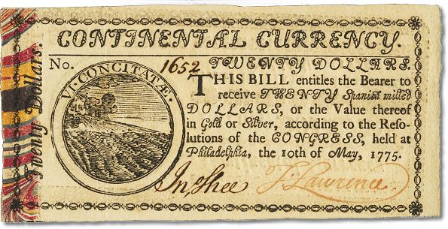

Slide 24
Jefferson Opposes the Bank
Jefferson and Madison believed Hamilton’s plan gave too much power to the federal government
They thought the bank was unconstitutional
Hamilton brought up the elastic clause – congress can make all laws which shall be necessary and proper to govern the nation
Notes:
KKEEP

Slide 25
Loose vs. Strict Interpretation
Hamilton believed in Loose Construction
Loose Construction: the government can take reasonable actions that the Constitution does not specifically forbid
Jefferson believed in Strict Construction
Strict Construction: the government should do only what the Constitution specifically says it can do
Notes:
KKEEP

Slide 26
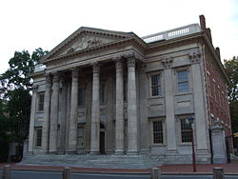
Bank of the US created
President Washington and Congress approved the charter for the bank
The bank helped stabilize the US economy
Notes:
KKEEP

Slide 27
Ch7 Section 3:
Challenges for the New Nation

Slide 28
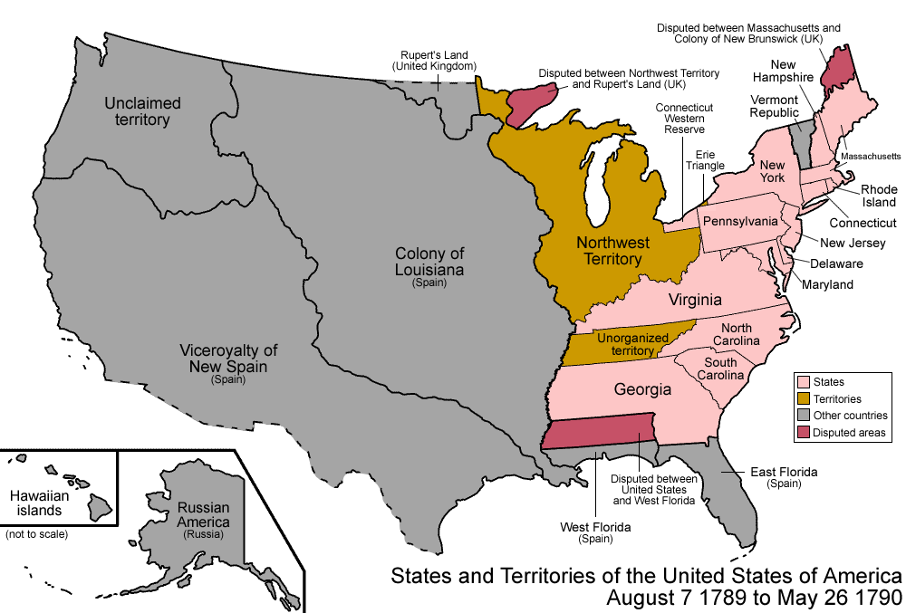

Slide 29
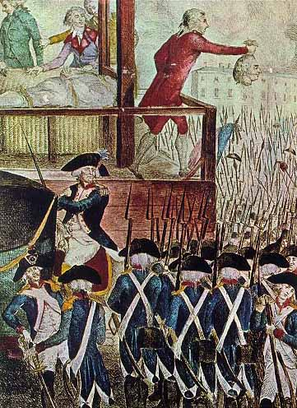
Remaining Neutral
French Revolution:
Inspired by the American Revolution,
the French people overthrew the government & created a republic
Notes:
1789 French beheaded their king and queen and created a republican govt.
Many Americans supported the French Revolution.
July 1789 The citizens of Paris attacked and captured the Bastille—fortress & prison that stood as a symbol of royal power.
King Louis XVI and Marie Antoinette were both beheaded.
King had taken thrown during economic problems in France. It was after the Seven Years War and helping the Americans with their revolution.
7 years War: Britain and Prussia and some smaller German states against France, Austria, Russia, and Swedon.

Slide 30
The Neutrality Proclamation
A few years later France and Great Britain went to war.
The French tried to involve the U.S.
Proclamation of Neutrality
  Stated that the U.S. would not take sides with any European countries at war.
The British began impressment of sailors & capturing American trade ships
Washington sent John Jay to negotiate
Notes:
Washington= neutral
Hamilton= pro British
Jefferson= help French
Madison questioned Washington’s authority to issue the proclamation without the approval of Congress.
French rep: Genet wanted to use privateers, but Washington said that would violate our neutrality.
Jefferson gets so upset over Hamilton’s power that he resigns as Sec. of State.

Slide 31
The French Question
France had asked for Privateers from President Washington
Privateers – private ships hired by a country to attack its enemies
Washington refused, it violated neutrality
Hamilton supported Washington
Jefferson thought Hamilton was interfering in foreign policy & resigned from cabinet in 1793

Slide 32
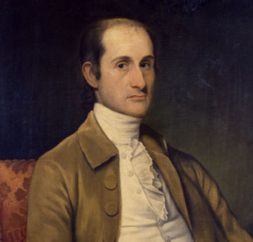
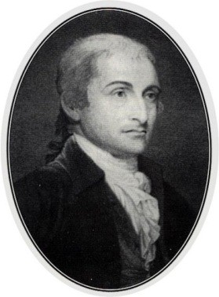
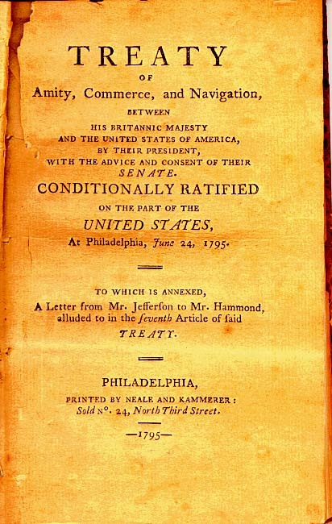
Jay’s Treaty
British ships are seizing American ships going to the French West Indies.
John Jay sent to work out a compromise.
British will pay for damages on American ships
British will abandon forts in the NW frontier.
US will pay debts it owes Britain.
Notes:
These were neutral merchant ships that were carrying food to the West Indies.
British officers were helping Native Americans fight settlers—giving them guns.
John Jay is the Chief Justice.
British knew US did not have a strong navy & relied heavily on British trade.
But, the British don’t want another war with the US.
Treaty settles disputes that had arisen between US & GB in the early 1790s.
South wanted GB to pay for the slaves they freed during the Am. Revolution—this didn’t happen!
Many thought the treaty did not punish GB enough for its actions and hurt US trade.
This is not a great treaty but according to Washington it is about all we can do.

Slide 33
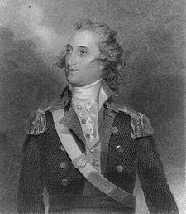
Pinckney’s Treaty
Spain disputed US/Florida border.
Spain closed port of New Orleans to US trade in 1784.
Pinckney wants:
  port reopened
  right of deposit in New Orleans
  border decided.
Spanish minister, Godoy agrees to all demands.
US/Florida border set at 31*N Latitude
Notes:
All goods go thru New Orleans.
Right of deposit—allows American boats to transfer goods in New Orleans without paying cargo fees.
Thomas Pinckney was US Ambassador to Spain.
Goday (Goh-thoy)tried to stall hoping Pinckney would give in and sign a treaty that favored the Spanish.
Godoy was afraid US and GB would join forces against Spain so he gave in.

Slide 34
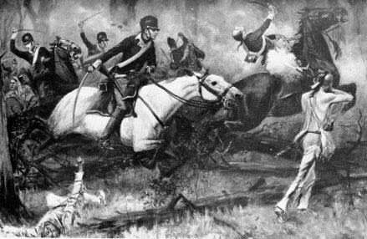
Struggle Over the West
Americans continued to settle in the Northwest
Native Americans protested
British provided guns to Natives
Natives were defeated @ Battle of Fallen Timbers.
The Battle of Fallen Timbers by R. F. Zogbaum,
from Harper's Magazine, 1896.
Notes:
Domestic problems
1790-Miami Chief Little Turtle defeated US forces under Gen. Harman.
1791 Native Americans defeated Gen. St. Clair’s troops.
1792 Washinton gives command of the Army in the West to Gen. Anthony Wayne.
They eventually build Ft. Greenville
Summer 1794 Little Turtle attacked a supply train near the Fort. Gen. Wayne attacked Native American towns and burned crops.
After this defeat British no longer helped the Native Americans and Little Turtle sought peace for his people.
Aug. 20, 1794 Native Americans were defeated @ the Battle of Fallen Timbers—this broke the strength of Indian forces.
Treaty of Greenville gave US claim to most Indian lands in the NW Territory
Guaranteed the safety of citizens there.
Native Americans would rec. $20,000 worth of goods & acknowledgement of their claim to the lands they still held.

Slide 35
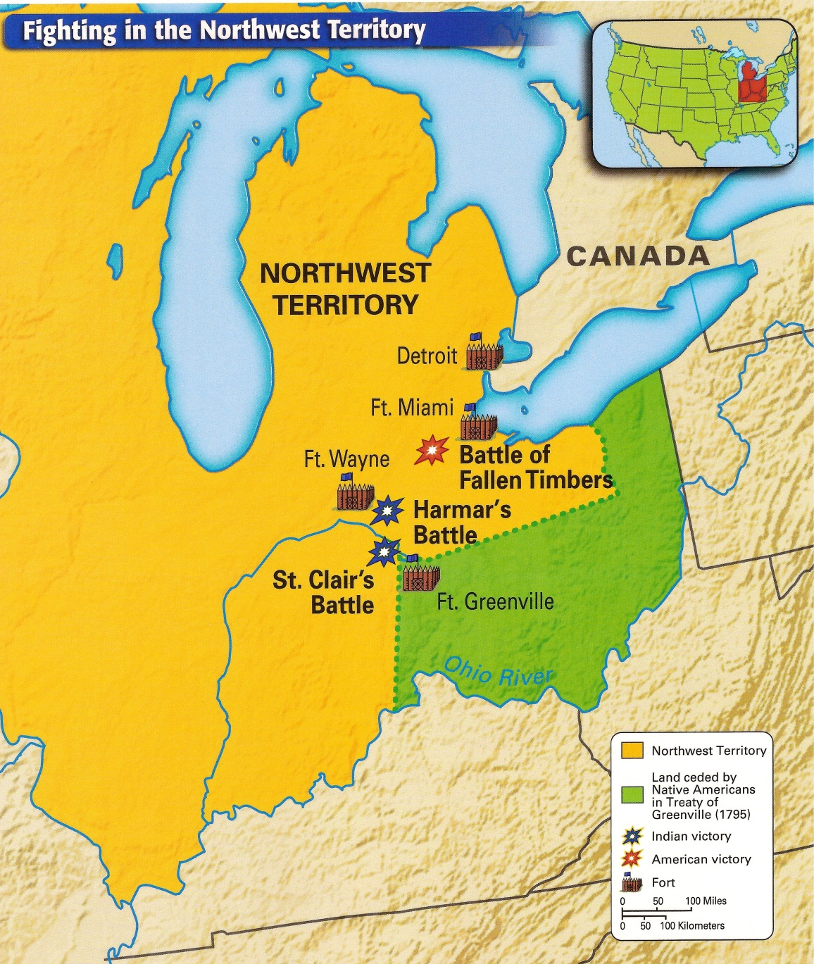

Slide 36
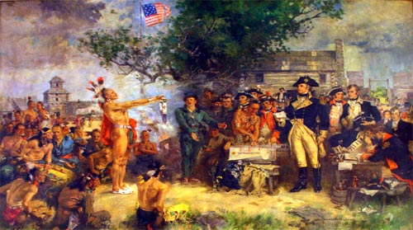
Treaty of Greenville gave U.S. claim to almost all Native lands in the Northwest Territory.

Slide 37
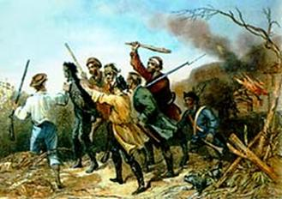
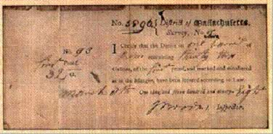
Whiskey Rebellion
Farmers resisted the tax on whiskey
Tax collectors were attacked and buildings were burned
A receipt for the whiskey tax, 1798.
A tax collector is tarred and feathered by anti-tax frontiersmen during the Whiskey Rebellion.
Notes:
Part of Hamilton’s plan to raise money to help pay the federal debt—and he was also testing the power of the federal government to control the states actions.
Western settlers already angry b/c they didn’t feel the Fed. Govt. was protecting them from Native American attacks & not allowing them enough opportunities to trade.
Corn crops made into whiskey—easier to transport than corn.
Cash was rare so whiskey became like money in the region.
Farmers who produced small amts of whiskey for trade said they couldn’t afford the tax.
Should be able to keep the money they made from a product they created themselves.
Washington issues a proclamation saying people had to obey the law.
Westerners disliked that district courts were so far away.
PA 1794 fighting breaks out—refuse to pay tax, tarred and feathered tax collectors
Some called themselves the new Sons of Liberty
Washington feels rebels threaten Federal authority.
Washington believed Congress had the right to pass and enforce the tax according to the Constitution.
Washington leads an army of 13,000 in Nov. 1794—most rebels had fled; NO BATTLE
First and only time a president led an army to battle.

Slide 38
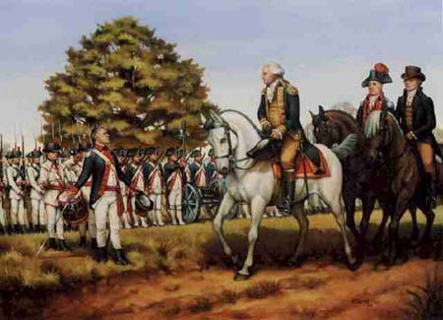
Washington led an army to quiet the rebellion
This showed people the government was willing to use force to maintain order

Slide 39
WASHINGTON SAYS FAREWELL
Lists the benefits of uniting the states under one government.
Warned against the dangers of political parties
  political unity was a key to national success.
Warned against dangers of foreign ties.
Warned against too much public debt.
Points out the need for education.
Notes:
James Madison & Alexander Hamilton helped write it.
Major dangers to the American republic:
Foreign ties
Political conflicts
Warns against permanent ties with other countries b/c choosing sides could draw us into war.
Believed political groups weakened the govt.
Warns against public debt—felt the govt. should not borrow money!

Slide 40
Ch7 Section 4:
John Adams’s Presidency
JOHN ADAMS overview

Slide 41
POLITICAL PARTIES DEVELOP
By 1796 Americans were beginning to divide into opposing groups and to form political parties (factions)
Within Washington’s Cabinet Hamilton & Jefferson had opposing views
Party differences were based on where and how people lived
  Businesspeople in the cities supported the Federalists
  Farmers in isolated areas supported the Democratic-Republicans

Slide 42

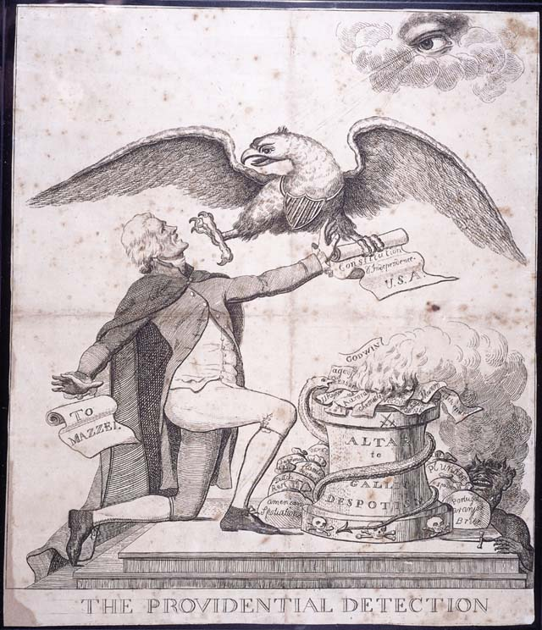
FEDERALIST
DEMOCRATIC-REPUBLICAN
Leader: Hamilton
Strong federal government.
Rule by Wealthy Class
British alliance
National Bank
Protective Tariffs
Implied powers of Constitution
Leader: Jefferson
Strong State government
Rule by the People
French Alliance
State Banks
Free Trade
Strict interpretation of Constitution
Notes:
Called Republicans BUT not related to today’s Republican party

Slide 43
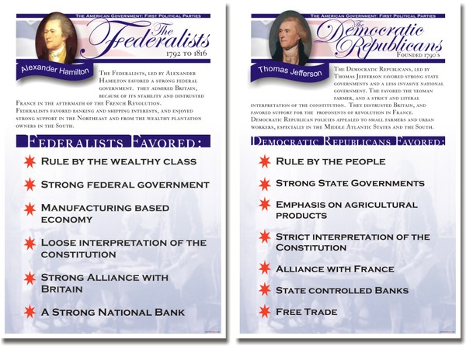

Slide 44
Election of 1796
Election of 1796; first time more than one candidate ran for president
Parties held Caucuses (meetings) to choose their candidate
Federalists chose John Adams and Thomas Pinckney as candidates.
Republicans chose Thomas Jefferson and Aaron Burr as candidates.
Good Friends Adams and Jefferson became Rivals
Notes:
John Adams: cousin of Sam Adams (Sons of Liberty). John was lawyer to British Capt. Of the Boston Massacure.
Married Abigail Smith (10 years younger)
5 children: Oldest John Quincy became 6th president
Delegate to the Continental Congress 1774-77
Wrote the constitution for MASS. (oldest state constitution)
Diplomat in Europe
1789-97 1st Vice President of US
Knew he was not well liked in the south and west but hoped his years of loyal public service would gather support.

Slide 45
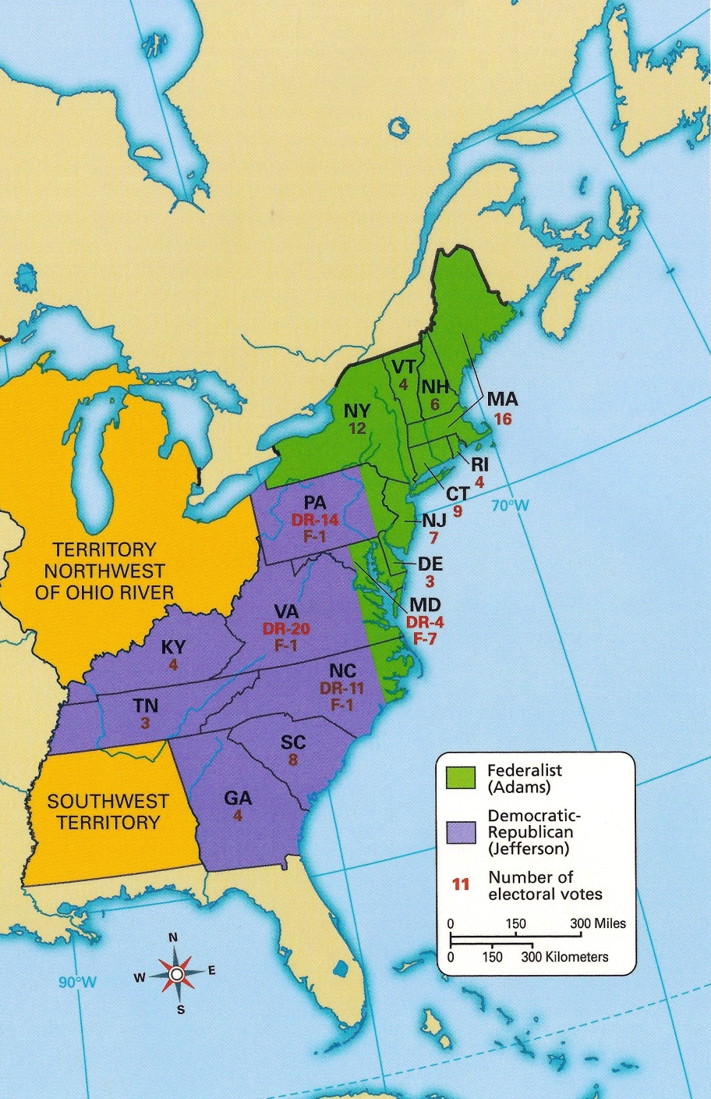
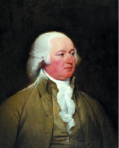
Election of 1796
Adams
  71 electoral votes
Jefferson
  68 electoral votes
Adams defeated Jefferson.
Whoever had the second most votes became vice president, so Jefferson joined Adams in office.
Notes:
1797-1801 2nd President of the US @ 61 years old; often in the shadow of Washington.
Kept Washington’s cabinet—this was a BIG mistake—they did not support him.
Wrote to Alex. Hamilton asking for guidance on national affairs.
Died: July 4, 1826 (within hours of Jefferson)
They were from opposing political parties but had to work together for the good of the nation!
Adams: lacks Washington’s dignity and charismatic personality. He was respected and known for his hard work, honesty, and intelligence.

Slide 46
XYZ AFFAIR
THE XYZ AFFAIR Video
Adams tried to improve American relationship with France.
Sent diplomats to negotiate to protect U.S. shipping.
They were met by three French agents.
Notes:
Tallyrand (French Prime Minister) refused to see the American agents unless they paid a bribe.
He sent 3 agents to meet American’s…they became known at XYZ.

Slide 47
The agents said a treaty would be discussed only in exchange for $250,000.
The French government also wanted a “loan” of $10 Mil.
The US diplomats refused.
When Adams told Congress of the talks, he replaced the agents names with the letters X, Y, Z.
Notes:
Adams tried to get Congress to let ships become armed.—Had to go public with XYZ Affair before Congress would move on defense.
Adams called Washington back as Commander in Chief of the new US Army
Congress est. a Dept. of the Navy.
The US, Constitution, and Constellation were the first warships of the US.

Slide 48
Federalists wanted war-Adams did NOT—too costly.
Treaty was eventually signed
Notes:
Adams was being pressured by member of his own party to go to war…he refused to ask Congress for war.
Adams forced two of his cabinet to resign for trying to block his peace efforts.

Slide 49
ALIEN AND SEDITION ACTS
Included four laws
Aimed at stopping the growth of Democratic-Republican party & to stop opposition to the war!
Supposedly to protect the country from foreigners
Notes:
Nations sometimes lose their bearings when confronted by an enemy. In a state of crisis or even panic, they implement measures that are later viewed as regrettable. From 1798 to 1800, the French were considered terrorists, pirating ships and making things uncomfortable for the fledgling American republic. The Federalist Party led a backlash against the French, and Thomas Jefferson and his Republican Party were seen as Francophiles. The XYZ Affair—a scandal centering on the fact that some French officials demanded bribes from American diplomats—brought relations between France and the U.S. to the breaking point. The Federalist Administration of President John Adams considered such solicitations to be grave insults. There were cultural differences as well. In the view of Abigail Adams, Frenchwomen were risqué at best.
The reaction to the threat from France came in the form of the Alien and Sedition Acts, which were championed by the Federalists, passed by Congress and signed by Adams in 1798. The Alien Act required immigrants to reside in the U.S. for 14 years instead of 5 to qualify for citizenship. The act also gave the President the legal right to expel those the government considered "dangerous." The Sedition Act punished "false, scandalous and malicious" writings against the government with fines and imprisonment. Most of those arrested under the Sedition Act were Republican editors, and instead of sending boatloads of aliens back to France, it resulted in no one's deportation. In a foreshadowing of the climate that inspired today's USA Patriot Act, at the turn of the century 200 years ago, it was common practice to question the patriotism of citizens, immigrants and the political opposition.
Jefferson, who was Vice President at the time, drafted his position in secret and wrote it into the Kentucky Resolutions of 1798. James Madison, in collaboration with Jefferson, subsequently authored the Virginia Resolutions. In the second and fourth of the Kentucky Resolutions, Jefferson cited the 10th Amendment, which gives the states powers not delegated to the government by the Constitution, to declare the Alien and Sedition Acts unconstitutional. Jefferson feared that a strong central government might put an end to slavery. Jefferson's fight against the Alien and Sedition Acts is often placed in the context of free speech, but it had unintended consequences beyond that. The Kentucky Resolutions were among the first to defend states' rights, and Jefferson had even threatened secession. Similar ideas helped spark the Civil War.
After Jefferson defeated Adams and was elected President in 1800, the Alien and Sedition Acts were allowed to expire. Adams, looking to distance himself from the mess, blamed the whole idea on Alexander Hamilton—who by then had been murdered by Aaron Burr.
These acts were used by the Adam’s administration to shut down opposition newspapers—Federalist controlled Congress
“war” The one Adams would NOT agree to with France.
WHAT ABOUT THE FIRST AMENDMENT?

Slide 50
ALIEN AND SEDITION ACTS
ALIEN ACT
SEDITION ACT:
Gave President power to deport any foreigner considered “dangerous to the peace and safety of the United States.”
Federalists hoped to silence French refugees who opposed them.
Made it a crime to speak or write critically about the government.
It’s purpose was to silence criticism.
Most controversial of the 4
Notes:
Jefferson & Madison felt these acts were a misuse of govt. power!!

Slide 51
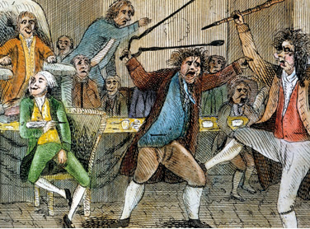
Notes:
Lyon had the distinction of being the first member to have an ethics violation charge filed against him when he was accused of "gross indecency" for spitting in Roger Griswold's face. Griswold, a Congressman from Connecticut, had insulted Lyon, calling him a scoundrel, which at the time was considered profanity. On January 30, 1798. Congress planned to have a meeting to remove William Blount, ofTennessee, from office. Griswold was trying to attract Lyon's attention, but Lyon was ignoring him on purpose, since they belonged to opposing political parties (Lyon was a Democratic-Republican and Griswold a Federalist). Griswold finally lost his temper and insulted Lyon. Their clash began when Lyon began a Congressional discussion by declaring himself a champion for the interest of the common man. Mockingly, Congressman Griswold asked if Lyon would be fighting with his wooden sword, a reference to Lyon's dismissal for cowardice during the Revolution. Furious, Lyon spat on the Congressman, earning himself the nickname "The Spitting Lyon". On February 15, 1798, Griswold retaliated by beating Lyon about the head with a wooden cane in view of other representatives on the Senate floor. Lyon retreated to a fire pit and defended himself with the tongs until other Congressmen broke up the fight.^{[2]} Griswold had to be pulled by his legs to urge him to let go of Lyon.^{[3]} Although the Ethics Committeerecommended censure, the House as a whole rejected the motion to censure him.^{[4]} Having married the daughter of Governor Chittenden, it is possible Lyon had too much influence to have been removed;^{[5]} though others argue it was because any actions taken against Lyon would have to be pursued against Griswold.^{[6]}
Lyon also has the distinction of being the only person to be elected to Congress while in jail. On October 10, 1798, Lyon was found guilty of sedition, in violation of the Alien and Sedition Acts; which prohibited malicious writing of the American government as a whole, or of the houses of Congress, or of the President. Lyon was the first person to be put to trial for violating the acts on charges of criticizing Federalist president John Adams for his pretense of going to war against France.
Representative Roger Griswold of Connecticut attacked Matthew Lyon of Vermont on the House Floor
February 15, 1798
After the House failed to expel Representative Matthew Lyon of Vermont for the “gross indecency” of spitting tobacco juice at Representative Roger Griswold of Connecticut, Griswold sought justice by attacking Lyon on the House Floor (then located in Philadelphia’s Congress Hall) with a cane. Lyon defended himself with a pair of fire tongs. Both Members were separated, and a resolution to expel them was defeated handily, 73 to 21. One contemporary cartoon depicted both Members jousting with cane and tongs in what the cartoonist described as “royal sport.” The episode revealed emergent political factionalism in the House at a time when formal parties had yet to fully form. Underlying the Lyon-Griswold incident was Griswold’s support for the John Adams administration’s hard line diplomacy toward France and military preparations in the event of hostilities. Lyon believed that preparations for war would eventually precipitate war.

Slide 52
KENTUCKY & VIRGINIA RESOLUTIONS
Documents that argue that the Alien & Sedition Acts were unconstitutional
Stated the Federal govt. could NOT pass these acts because they interfered with state govt.
  Cited the 10th Amendment
Resolutions did not have the force of national law, but supported the idea that states could challenge the Federal Govt.
Notes:
Resolutions affirmed principle of states’ rights
States’ Rights
Limiting the federal government to those powers specifically outlined by the Constitution
Reserving to the states all other powers not expressly forbidden to them

