Slide 1
Expanding West
Section 1:
Trails to the West
Section 2:
The Texas Revolution
Section 3:
The Mexican-American War
Section 4:
The California Gold Rush

Slide 2
Section 1: Trails to the West
SECTION 1
Key Terms & People:
John Jacob Astor- owner of American Fur Company one of largest trading Companies in America
Mountain Men – name for Fur traders and trappers
Oregon Trail – 2,000 mile long trail from Iowa & Missouri west to Oregon Country
Santa Fe Trail – wagon trail from Missouri to Santa Fe New Mexico
Mormons – members of Joseph Smiths church of Latter Day Saints
Brigham Young – Brigham Young became Leader of the Mormons & settled in Utah

Slide 3
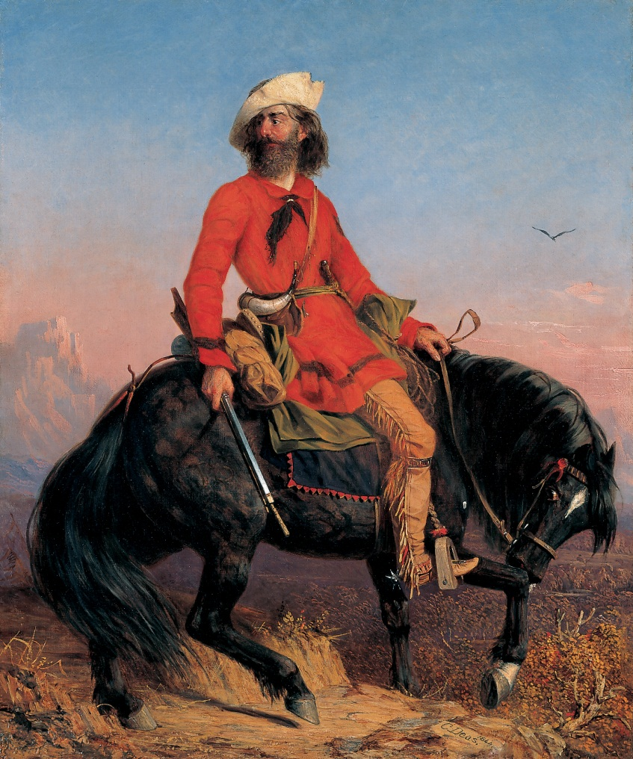
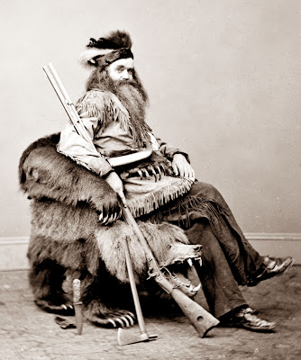
SECTION 1
Mountain Men
Fur traders and trappers were some of the first Americans to explore the West
Notes:
Between the Lewis & Clark Expedition (1804-1806) and the US Civil War from 1861-1865, the famous “mountain men” were central non-Indigenous figures in the American West. Based in the Rocky Mountains, these men were fur trappers, explorers and provided much of the geographic knowledge necessary for later non-Indigenous settlers moving westward.
“The Rocky Mountain Man – Long Jakes” (Artist: Charles Dea, 1818-1867)
It has been estimated that approximately 3,000 mountain men lived in, trapped and explored the Rockies between the 1820s and the 1840s – the peak of the mountain man era had occurred by the year 1840. From 1825-1840, the mountain men would gather at a “rendezvous” in late summer to socialize, trade goods and purchase supplies. The event could last for several weeks and could be wild affairs with drinking, dancing, gambling, and impromptu competitions such as wrestling matches and tomahawk throwing competitions. Indigenous groups would also attend the rendezvous gathering to trade for goods.
One of the original motivators for the Rocky Mountain fur trade was fashion – beaver fur was used for popular beaver felt hats in Europe and the Eastern US. This fashion craze lasted for approximately fifty years – i.e. from the late 18th century to the 1840s. While some continued the mountain men lifestyle into the 1880s, by the 1840s the peak mountain man era had ended. Both the supply of beaver and demand for its fur decreased – the supply from over-trapping and the demand from a shift in fashion styles. Some mountain men would move into work as scouts, guides and hunters for settlers emigrating west.
The History channel: http://westernsreboot.com/2012/10/02/mountain-men-on-the-history-channel-they-never-left/
this picture of Seth Kinman, Mountain Man, Bear Hunter, Indian Fighter and Story Teller. This picture was taken in 1865. Kinman was actually a friend of Abraham Lincoln and he was a master of garnering publicity for his rugged look and unusual exploits.
http://old-photos.blogspot.com/2012_11_01_archive.html

Slide 4
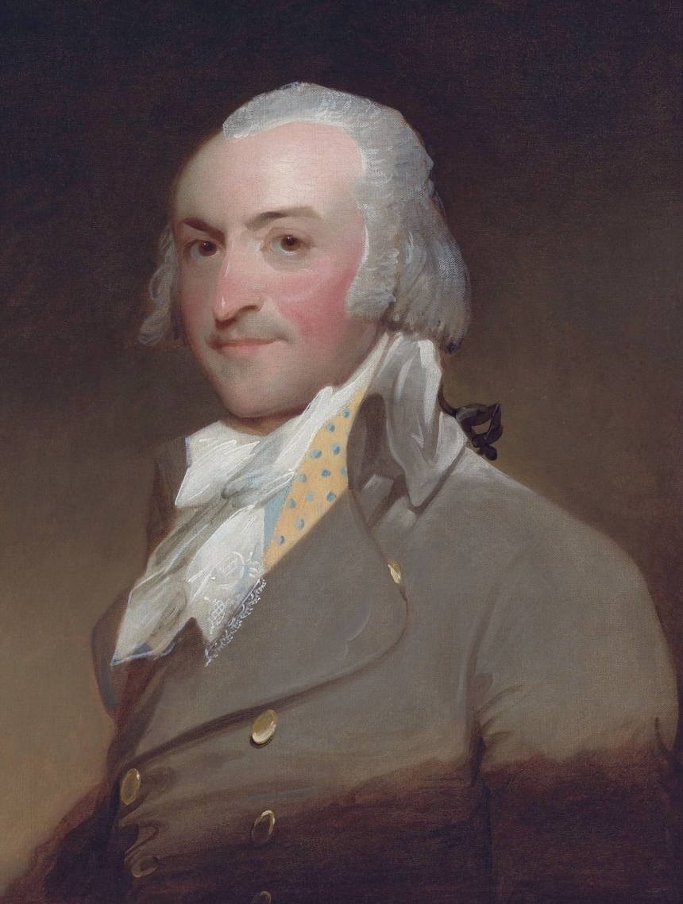
John Jacob Astor
SECTION 1
created one of the largest fur businesses.
Astor founded Astoria, one of the first settlements in Oregon Country.
Notes:
JJ Astor Oil painting by Gilbert Stuart, 1794
John Jacob Astor (born Johann Jakob Astor;^{[4]} July 17, 1763 – March 29, 1848) was a German-American business magnate, merchant andinvestor who was the first prominent member of the Astor family and the first multi-millionaire in the United States. He was the creator of the first trustin America.
He went to the United States following the American Revolutionary War and built a fur-trading empire that extended to the Great Lakes region andCanada, and later expanded into the American West and Pacific coast. He also got involved in smuggling opium. In the early 19th century he diversified into New York City real estate and later became a famed patron of the arts.
Astor took advantage of the Jay Treaty between Great Britain and the United States in 1794, which opened new markets in Canada and the Great Lakes region. Then in London, Astor at once made a contract with the Northwest Company of Montreal and Quebec (then the magnate of the Canadian Northwest fur trade). He imported furs from Montreal to New York, and shipped them to all parts of Europe.^{[12]} By 1800 he had amassed almost a quarter of a million dollars, and had become one of the leading figures in the fur trade. In 1800, following the example of the Empress of China, the first American trading vessel to China, Astor traded furs, teas and sandalwood with Canton in China, and greatly benefited from it.
The U.S. Embargo Act in 1807, however, disrupted his import/export business. With the permission of President Thomas Jefferson, Astor established the American Fur Company on April 6, 1808. He later formed subsidiaries: the Pacific Fur Company, and the Southwest Fur Company (in which Canadians had a part), in order to control fur trading in the Columbia River and Great Lakes areas.
His Columbia River trading post at Fort Astoria (established in April 1811) was the first United States community on the Pacific coast. He financed the overland Astor Expedition in 1810–12 to reach the outpost. Members of the expedition were to discover South Pass, through which hundreds of thousands of settlers on the Oregon, Mormon, and California trails passed through theRocky Mountains.
Astor's fur trading ventures were again disrupted, when the British captured his trading posts during the War of 1812. In 1816, he joined the opium smuggling trade. His American Fur Company purchased ten tons of Turkish opium, then shipped the contraband item to Canton on the packet ship Macedonian. Astor later left the China opium trade and sold solely to England.^{[13]}
Astor's business rebounded in 1817 after the U.S. Congress passed a protectionist law that barred foreign traders from U.S. territories. The American Fur Company came to dominate trading in the area around the Great Lakes. In 1822, Astor established the Astor House on Mackinac Island as headquarters for the reorganized American Fur Company, making the island a metropolis of the fur trade. A lengthy description based on documents, diaries etc. was given by Washington Irving in his travelogue Astoria. Astor's commercial connections extended over the entire globe, and his ships were found in every sea.^{[9]}
In 1804, Astor purchased from Aaron Burr what remained of a 99-year lease on property in Manhattan. At the time, Burr was serving as vice president under Thomas Jefferson and desperately needed the purchase price of $62,500. The lease was to run until 1866. Astor began subdividing the land into nearly 250 lots and subleased them. His conditions were that the tenant could do whatever they wish with the lots for twenty-one years, after which they must renew the lease or Astor would take back the lot.
the fifth richest person in American history.
n his will, he left $400,000 to build the Astor Library for the New York public (later consolidated with other libraries to form New York Public Library), and $50,000 for a poorhouse and orphanage in his German hometown, Walldorf. The Astorhaus is now a museum honoring the city's ancestor Johann Jakob Astor and a renowned festhall for marriages. Further Astor donated $25,000 to theGerman Society of the City of New York, whose chairman he was from 1837 until 1841. Also $30,000 were to be used for a professor's chair in German literature at Columbia University, but due to differences with the deanship this donation was erased from the testament.

Slide 5
Oregon Trail
SECTION 1
Settlers were lured by rich resources and the mild climate.
The trail was 2,000 miles
beginning in Iowa or Missouri and ending in Oregon or California.
Hard journey because of food shortages, bad weather, and mountains and rivers that were difficult to cross.
Notes:
Longest and most famous trail
Journey took 6 months

Slide 6
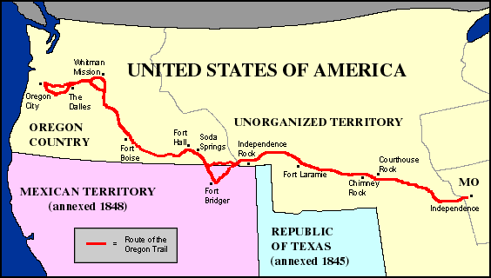
Oregon Trail
SECTION 1

Slide 7
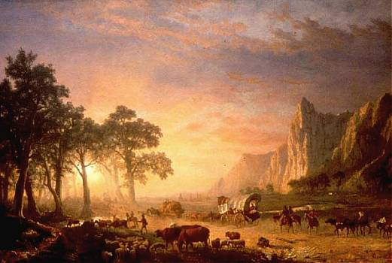
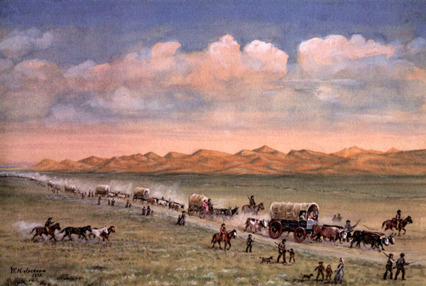
Notes:
The Oregon Trail Albert Bierstadt 1868 – one with the sun, the good one
Oregon Trail pioneers pass through the sand hills,
painting by William Henry Jackson.
http://www.legendsofamerica.com/we-oregontrail.html
The Oregon Trail became one of the key migration routes that pioneers crossed on their way to the vast west. Spanning over half the continent the trail proceeded over 2,170 miles west through territories that would later become Missouri, Kansas, Nebraska,Wyoming, Idaho, and Oregon. The long journey through endless plains, rolling hills, and mountain passes, began in Independence,Missouri and ended at the Columbia River in Oregon.
The route of the Oregon Trail began to be scouted as early as 1823 by fur traders and explorers. By the 1830s, it was used regularly by mountain men, traders, missionaries, and military expeditions.
At the same time, small groups of individuals and the occasional family attempted to follow the trail, with some succeeding in arriving at Fort Vancouver in Washington.
On May 16, 1842 the first organized wagon train on the Oregon Trail set out from Elm Grove, Missouri, with more than 100 pioneers. The following year, an estimated 800 immigrants arrived in the Willamette Valley. Hundreds of thousands more would follow, especially after gold was discovered in California in 1849.While the first few parties organized and departed from Elm Grove, Missouri, theOregon Trail's generally designated starting point was Independence or Westport,Missouri. The trail ended at Oregon City, Oregon, which was the proposed capital of the Oregon Territory at the time. However, many settlers branched off or grew exhausted short of this goal and settled at convenient or promising locations along the way.
At many places along the trail, alternate routes called "cutoffs" were established, either to shorten the trail, or to get around difficult terrain. The Lander and Sublette cutoffs provided shorter routes through the mountains than the main route, bypassing Fort Bridger,Wyoming. In later years, the Salt Lake cutoff provided a route to Salt Lake City.
The Oregon Trail was too long and arduous for the standard Conestoga wagons used in the eastern U.S. for most freight transport. These big wagons had a reputation for killing their oxen teams approximately two thirds along the trail and leaving their unfortunate owners stranded in desolate, isolated territory. The only solution was to abandon all belongings and traipse onward with the supplies and tools that could be carried or dragged. In one case in 1846, the Donner Party, en route to California, was stranded in the Sierra Nevada in November and had to resort to cannibalism to survive.
This led to the rapid development of the prairie schooner. Though this wagon looked similar, it was approximately half the size of the big Conestogas and also manufactured in quantity by the Conestoga Brothers. It was designed for the conditions and was a marvel of engineering in its time.
Pioneers on the Oregon Trail followed various rivers and used landmarks along the trail to guide their way and gauge their progress. Within Nebraska, the Oregon Trail followed the Platte River and then the North Platte River into Wyoming. Along this part of the journey, the Great Plains started giving way to bluffs and hills that were the precursor of the Rocky Mountains. After crossing the Rockies through South Pass, the trail followed the Snake River to the Columbia River. From there, emigrants had the option of either rafting down the Columbia to Fort Vancouver, or taking the Barlow Road to the Willamette Valley and other destinations in what are now the states of Washington and Oregon.
Many rock formations became famous landmarks that Oregon Trail pioneers used to navigate, as well as leave messages for pioneers following behind them.
The first landmarks the pioneers encountered were in WesternNebraska, such as Court House Rock, Chimney Rock, and Scotts Bluff (where wagon ruts can still be seen to this day). Further west, in Wyoming, you can still read the names of pioneers carved into a landmark bluff called Register Cliff.
A number of other trails followed the Oregon Trail for part of its length. These include the Mormon Trail from Illinois to Utah, and the California Trail to the gold fields of California.
Other migration paths for early settlers prior to the establishment of the transcontinental railroads involved taking passage on a ship rounding the Cape Horn of South America or to the Isthmus (now Panama) between North and South America. There, an arduous mule trek through hazardous swamps and rain forests awaited the traveler. A ship was typically then taken to San Francisco,California.
The trail was still in use during the Civil War, but traffic declined after 1869 when the transcontinental railroad was completed.
However, in its more than 25 years of regular use, the trail carried an estimated 300,000 emigrants to the vast west, a trip that took about five months to complete. The trail continued to be used into the 1890s, when modern highways began to take its place, eventually paralleling large portions of the trail. Today, U.S. Highway 26 follows the Oregon Trail for much of its length.
Some of the original route from our nation's early days still remain today as reminders of our historic past. The Oregon National Historic Trail is an extended trail that follows much of the original path of the Oregon Trail.
In 1968, Congress enacted the National Trails System Act and in 1978, National Historic Trail designations were added. The National Historic Trails System commemorates these historic routes and promotes their preservation, interpretation and appreciation.
In 1995, the National Park Service established the National Trails System Office in Salt Lake City, Utah. The Salt Lake City Trails Office administers the Oregon, the California, the Mormon Pioneer Trail and the Pony Express National Historic Trails.
The National Trails System does not manage trail resources on a day-to-day basis. The responsibility for managing trail resources remains in the hands of the current trail managers at the federal, state, local and private levels.
National Historic Trails recognize diverse facets of history such as prominent past routes of exploration, migration, trade, communication and military action. The historic trails generally consist of remnant sites and trail segments, and thus are not necessarily contiguous.

Slide 8
Santa Fe Trail
SECTION 1
The route led from Independence, Missouri, to Santa Fe, New Mexico.
Was originally a Native American trading route
Traders used the route to trade American goods for Mexican goods
traders made high profits.
Difficult journey due to hot desert and rough mountains
Notes:
Served mostly commercial functions
http://www.sangres.com/national-trails/santafetrail/index.htm#.UQ_4C6VkiSo
The Santa Fe Trail stirs imaginations as few other historic trails can. For 60 years, the Trail was one thread in a web of international trade routes. It influenced economies as far away as New York and London. Spanning 900 miles of the Great Plains between the United States (Missouri) and Mexico (Santa Fe), it brought together a cultural mosaic of individuals who cooperated and sometimes clashed. In the process, the rich and varied cultures of Great Plains Indian peoples caught in the middle were changed forever. Soldiers used the trail during the 1846-1848 Mexican-American War, 1840s border disputes between the Republic of Texas and Mexico, and America's Civil War. The troops also policed conflicts between traders and Indian tribes. With the traders and military freighters tramped a curious company of gold seekers, emigrants, adventurers, mountain men, hunters, American Indians, guides, packers, translators, invalids, reporters, and Mexican children bound for schools in Los Estados Unidos.
Spain jealously protected the borders of its New Mexico colony, prohibiting manufacturing and international trade. Missourians and others visiting Santa Fe told of an isolated provincial capital starved for manufactured goods and supplies - a potential gateway to Mexico's interior markets. In 1821, the Mexican people revolted against Spanish rule. With independence, they unlocked the gates of trade, using the Santa Fe Trail as the key. Encouraged by Mexican officials, the Santa Fe tradeboomed, strengthening and linking the economies of Missouri and Mexico's northern provinces. The close of the Civil War in 1865 released America's industrial energies, and the railroad pushed westward, gradually shortening and then replacing theSanta Fe Trail.
In 1821 the eastern terminus was Franklin, Missouri; by 1832, Independence, Missouri; and by 1845, Kansas City, Missouri. Textiles and hardware were traded west, silver, mules and furs were traded east.
Life on the Trail
Movies and books often romanticize Santa Fe Trail treks as sagas of constant peril, replete with violent prairie storms, fights with Indians, and thundering bison herds. In fact, a glimpse of buffalo, elk, pronghorns, or prairie dogs was sometimes the only break in the tedium of the 8 week journey. Trail travelers mostly experienced dust, mud, gnats, mosquitos, and heat. But, occasional swollen streams, wildfires, hailstorms, strong winds, or blizzards could imperil wagon trains.
At dawn, trail hands scrambled in noise and confusion to round up, sort and hitch up the animals. The wagons headed out, the air ringing with cries of "All's set!" and soon, "Catch up, catch up!" and "Stretch out!" Stopping at mid-morning, crews unhitched and grazed the teams, hauled water, gathered wood or buffalo chips for fuel, and cooked and ate the day's main meal, from a monotonous daily ration of 1 lb. of flour, 1 lb. or so of sowbelly bacon, 1 oz. of coffee, 2 oz. of sugar, and a pinch of salt. Beans, dried apples, or buffalo and other game were occasional treats. Crews then repaired their wagons, yokes and harnesses; greased wagon wheels; doctored animals; and hunted. They moved on soon after noon, fording streams before that night's stop because overnight storms could turn trickling creeks into raging torrents before morning. And stock that was cold in the harness first thing in the morning tended to be unruly. At day's end, crews took care of the animals, made necessary repairs, chose night guards, and enjoyed a few hours of well-earned leisure and sleep.
"The Vast Plain, Like a Green Ocean"
Westward from Missouri, forests - and then tall-grass prairie - give way to shortgrass prairie in Kansas. In western Kansas, roughly at the Hundredth Meridian, semi-arid conditions develop. For Trail travelers, venturing into the unknown void of the Plains could hold the fear of hardship or the promise of adventure. Long days travelling through seemingly endless expanses of tall- and shortgrass prairie, with a few narrow ribbons of trees along waterways, evoked vivid descriptions. "In spring, the vast plain heaves and rolls around like a green ocean," wrote one early traveler. Another marveled at the mirage in which "horses and the riders upon them presented a remarkable picture, apparently extending into the air ... 45 to 60 feet high ... At the same time I could see beautiful clear lakes of water with ... bullrushes and other vegetation..." Other Trail travelers dreamed of cures for sickness from the "purity" of the plains. (The photo to the right is from a 1930's aerial shot showing existing wagon ruts in the area around Iron Spring)
Deceptively empty of human presence as the prairie landscape might appear, the lands the Trail passed through were the long-held homelands of many American Indian peoples. Here were the hunting grounds of the Comanches, Kiowas, southern bands of Cheyennes and Arapahos, and Plains Apaches as well as the homelands of the Osages, Kansas, Jicarilla Apaches, Utes, and Pueblos. Most early encounters were peaceful negotiations centering on access to tribal lands and trade in horses, mules, and other items that Indians, Mexicans and Americans coveted. As Trail traffic increased, so did confrontations - resulting from misunderstanding and conflicting values - that disrupted traditional American Indian lifeways and Trail traffic. Mexican and American troops provided escorts for wagon trains. Growing numbers of Trail travellers and settlers moved west, bringing the railroad with them. As lands were parceled out and the bison were hunted nearly to extinction, Indian peoples were pushed aside or assigned to reservations.
Soldiers and Forts
Suspicion and tension between the United States and Mexico accelerated in the 1840s, because Americans wanted territorial expansion. Texans raided into New Mexico, and the United States annexed Texas. The Mexican-American War erupted in 1846. General Stephen Watts Kearny led his Army of the West down the Santa Fe Trail, to take and hold New Mexico and Upper California and to protect American traders on the Trail. He marched unchallenged into Santa Fe, and, although communities such as Taos and Mora staged revolts, American control prevailed. In 1848 the Treaty of Guadalupe Hidalgo ended the war.
The Santa Fe Trail became the lifeline for protection and communication between Missouri and Santa Fe. From a succession of military forts such as Mann (1847), Atkinson (1850), Union (1851), Larned (1859), and Lyon (1860), the Army controlled conflicts between American Indians and Trail travelers. As the military presence grew, freighting and merchant operations burgeoned. In 1858, many of the 1800 wagons traveling the Santa Fe Trail carried military supplies.
In 1862, the Civil War arrived in the West. Confederates from Texas pushed up the Rio Grande Valley into New Mexico, intent on seizing the territory and Fort Union, and ultimately, the rich Colorado gold fields. Albuquerque and Santa Fe fell. But the tide turned at Glorieta Pass, New Mexico, on the Santa Fe Trail in the most decisive western battle of the Civil War. Union forces secured victory when they torched the nearby Confederate supply train. The Confederates abandoned hope of reachingFort Union - and of keeping their foothold in New Mexico. The Union Army held the Southwest and its vital Santa Fe Trail supply line.
Commerce of the Prairies
The story of the Santa Fe Trail is a story of business - international, national and local. In 1821, William Becknell, bankrupt and facing jail for debts, packed goods from Missouri to Santa Fe and made a profit (some say he was waiting at the Arkansas River, near where Bent's Old Fort would be, for word to come that Mexico had declared independence from Spain and that he would be safe to cross the river into Mexican territory). Entrepreneurs and other experienced business people followed - James Webb, Antonio José Chavez, Charles Beaubien (of the Beaubien-Mirandaand Sangre de Cristo Land Grants), David Waldo, and others.
The Santa Fe trade developed into a complex web of international business, social ties, tariffs, and laws. Merchants in Missouri and New Mexico extended connections to New York, London and Paris. Traders exploited legal and social systems to facilitate business. Partnerships such as Goldstein, Bean, Peacock & Armijo formed and dissolved. David Waldo "converted" to Catholicism - and also became a Mexican citizen. Dr. Eugene Leitensdorfer, of Missouri, married Soledad Abreu, daughter of a former New Mexico governor. Trader Manuel Alvarez claimed citizenship in Spain, the United States and Mexico.
After the Mexican-American War, Trail trade and military freighting boomed. Both firms and individuals obtained and subcontracted lucrative government contracts. Others operated mail and stagecoach services.

Slide 9
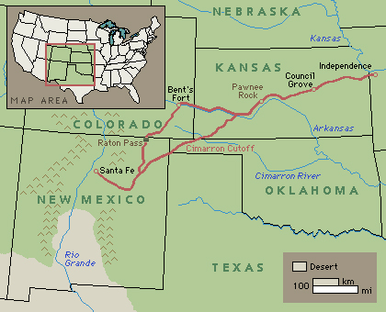
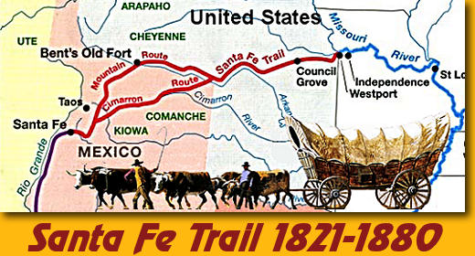
Notes:
http://www.richardbealblog.com/santa-fe-trail/
In 1821 William Becknell started moving goods along an informal trail from Franklin, Missouri to Santa Fe, New Mexico and others soon followed. In 1846 US Cavalary troops used the trail to invade New Mexico as the Mexican-American War began. The original path was created by Spaniards finding ways to reach the area of today’s mid-west US for exploration and possible trade.
The Santa Fe National Historic Trail crosses the five states of Missouri, Kansas, Colorado, Oklahoma, and New Mexico. The 900 mile long trail was formalized in 1848 and by the late 1860′s more than 5,000 wagons traveled the trail each year. Merchants pushed trains of freight wagons loaded with manufactured goods westward. In Santa Fe these were traded for burros, furs, gold, horses, and silver which moved back eastward. The trail was also used by stagecoach lines, thousands of gold seekers heading to the California and Colorado gold fields, adventurers, fur trappers, and emigrants.
The route crossed Comanche and Apache territories who insisted on a “toll” for crossing the areas where they lived and hunted. Wikipedia reports that “Americans routinely traded with the Comanche along the trail, sometimes finding the trade in Comancheria more profitable than that of Santa Fe.” And travelers found it a harsh environment with storms, mountains, deserts and little water.
The arrival of the train in about the 1860s negated the need for the Santa Fe trail route although people continued to use it both for trade and transportation until the early 1900s.

Slide 10
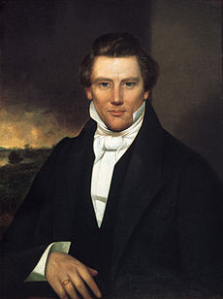
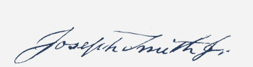
The Mormons traveled west in search of religious freedom
SECTION 1
Joseph Smith founded the Church of Jesus Christ of Latter-day Saints in western New York in 1830.
Church members were persecuted because of beliefs,
including polygamy (one man married to several women).
Joseph Smith was murdered by a mob in 1844 in Carthage Illinois.
Notes:
Biographical Sketch: Born December 23, 1805, in Sharon, Vermont, Joseph Smith Jr. was the fifth of eleven children of Joseph Smith and Lucy Mack. He worked on the family farm in Vermont and later in western New York. A series of remarkable spiritual experiences prepared him for his prophetic calling. Beginning in 1820 at Palmyra, New York, Joseph Smith saw God the Father and Jesus Christ in vision. Through revelation, he translated and published the Book of Mormon, organized The Church of Jesus Christ of Latter-day Saints on April 6, 1830, and received revelations to guide the Church. By inspiration, he called Apostles and other Church leaders, defined doctrines, and taught the principles and ordinances that would lead to exaltation. Under his leadership, Latter-day Saints founded communities in Ohio, Missouri, and Illinois. He was sustained as First Elder of the Church on April 6, 1830. On June 27, 1844, at Carthage, Illinois, Joseph Smith died a martyr to his faith.
http://www.lds.org/churchhistory/presidents/controllers/potcController.jsp?leader=1&topic=facts

Slide 11
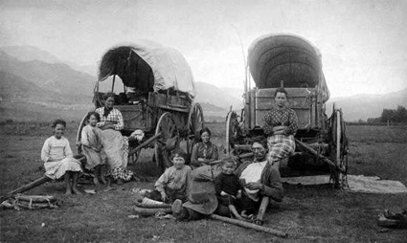

Slide 12
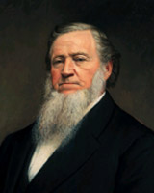
Mormons move to Utah
SECTION 1
Brigham Young became the new head of the church and moved the group to Utah.
Thousands of Mormons took the Mormon Trail to Utah.
By 1860, there were about 40,000 Mormons in Utah.
Notes:
Brigham Young was born June 1, 1801, in Whitingham, Vermont. In 1835, three years after he joined the Church, he was called to the Quorum of the Twelve Apostles. As successor to Joseph Smith, he led the migration west in 1846–47 to the Rocky Mountains and founded Salt Lake City. He was sustained as President of the Church on December 27, 1847. As Church President and Territorial Governor of Utah, he established Latter–day Saint settlements in Utah and throughout the American West. Under his direction, construction commenced on the Salt Lake, St. George, and Logan temples. He brought the telegraph and the railroad to Utah and encouraged cooperative industry among Latter-day Saints, and he encouraged excellence and refinement in every aspect of life. He died August 29, 1877 in Salt Lake City after nearly 30 years as Church President.
http://www.lds.org/churchhistory/presidents/controllers/potcController.jsp?leader=2&topic=facts

Slide 13
Section 2: The Texas Revolution
SECTION 2
Key Terms & People:
Father Hidalgo y Costilla – Mexican Priest who led failed Mexican Revolution against Spain in 1810
Empresarios – agents hired by Mexico to bring settlers to Texas
Stephen F. Austin – 1822 started
Antonio Lopez de Santa Anna – Mexican General charged with putiing down the revolution in Texas
The Alamo – abandoned Mission near San Antonio that became an important battle in Texas Independence
Battle of San Jacinto - Texans captured Santa Anna & forced him to declare Texas Independent

Slide 14
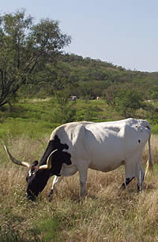
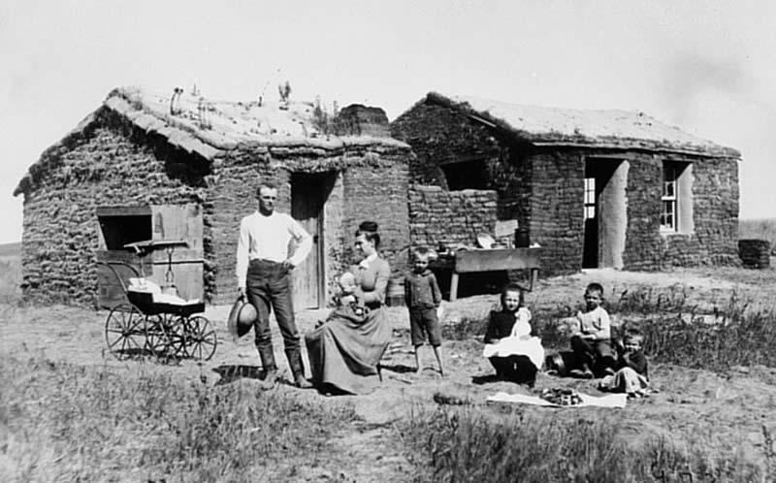
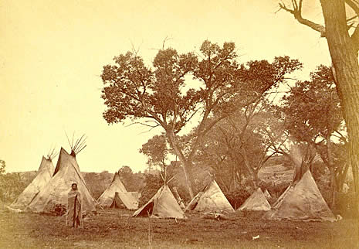
Many American settlers moved to Texas after Mexico achieved independence from Spain
SECTION 2
Mexico gained independence in 1821.
The new Mexican government hired empresarios, or agents, to bring settlers to Texas.
Notes:
http://www.texasbeyondhistory.net/forts/images/frontierfamily.html
While preserving some traditions of their homeland, settlers on the Texas frontier were transformed by their experiences, becoming "westerners.“
Longhorn cattle, a hardy hybrid of Spanish criollo stock and English cattle," thrived on the Texas plains and prairies, giving rise to the occupation known as "cow hunting."

Slide 15
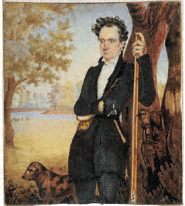
Stephen F. Austin
SECTION 4
Empresario who started a colony on lower the Colorado River in 1822.
Success attracted more settlers, who received free land in exchange for obeying Mexican laws.
Mexico was concerned about the number of Americans and banned further settlement.
Portrait of Stephen F. Austin, by William Howard, 1833. Miniature watercolor portrait on ivory, James Perry Bryan Papers.
Notes:
http://www.cah.utexas.edu/exhibits/Pena/english/exhibit1.html
William Howard executed this watercolor of Stephen F. Austin in Mexico City in 1833, just before Austin's arrest in Saltillo in January 1834 on suspicion of trying to incite insurrection in Texas. It depicts Austin in his hunting costume with his dog Cano.
Bio at: http://www.tamu.edu/faculty/ccbn/dewitt/adp/history/bios/austin/austin.html

Slide 16
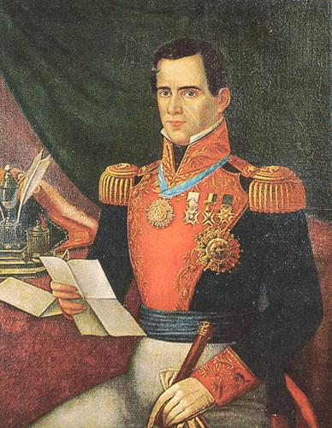
General Antonio López de Santa Anna
became the ruler of Mexico.
called "the Napoleon of the West"
Mexico lost half its territory under his leadership
the Texas Revolution
Mexican Cession of 1848.

Slide 17
Texans revolted against Mexican rule and established an independent nation
SECTION 2
War began October 1835 in a battle at Gonzales, Texas.
Texans declared independence on March 2, 1836.
The Republic of Texas was established.
Sam Houston was named head of the Texas army.
Stephen F. Austin went to the United States to seek money and troops.

Slide 18
Battle at the Alamo
SECTION 2
Texans’ actions angered Santa Anna.
Texas force of fewer than 200, led by Colonel Jim Travis, occupied Alamo mission near San Antonio.
From February 23 to March 6, 1836, Texans held out against huge Mexican army.
All defenders killed in Mexican attack on March 6.

Slide 19
Notes:
When Spain ceded Florida to the United States after the Adams-Onis Treaty of 1819, the United States agreed to relinquish its claim to Texas. Unfortunately for Spain, their vast empire was about to crumble throughout the New World. It started with Texas.
Spain’s influence in Texas was minimal at best. After Mexico declared its independence from Spain in 1821, Texas was a forgotten land. The new nation of Mexico certainly lacked the authority or finances to manage the vast area. However, some opportunistic Americans saw potential for profit in Texas. Stephen F. Austin, the son of a Missouri man who had negotiated a large-land grant with the Mexican government in the hopes of building a local economy, set about colonizing Texas. By 1830, Austin had attracted 25,000 settlers and 2,000 slaves to Texas. Their plan was to grow cotton.
As the new Mexican government saw Austin’s colony, it attempted to exert more control over the region, claiming that the terms of the original land-grant had been violated (settlers refused to convert to Roman-Catholicism – the national religion of Mexico). Furthermore, the Mexican government refused to allow any more slaves to immigrate to Mexico and placed taxes on goods imported from America. As expected, the colonists became disgruntled. The situation worsened when the Mexican government jailed Stephen A. Austin for urging Texas to self-govern.
In 1836, General Antonio Lopez de Santa Anna and 6,000 troops marched to Texas to subdue the Texans. On February 23, Santa Anna besieged the mission known as The Alamo in San Antonio. Santa Anna’s demand for surrender was answered with a defiant cannon blast authorized by Col. William Barret Travis. The siege lasted for two weeks. On March 6, Santa Anna and his army stormed the mission and killed every Texan who resisted. Just four days earlier, On March 2, the Texans declared independence, legalized slavery, and formed a provisional government. They named Sam Houston commander of their army. Because the stand at The Alamo lasted two weeks, Sam Houston had time to prepare his army and plans of attack. On April 21, Houston’s army of 800 Texans routed the Mexican army of 1,600 at San Jacinto, Texas. In the battle, General Santa Anna was captured, and Texas became independent. Nine years later, after much debate and deliberation, Texas became the 28th state. As a result, Mexico broke all diplomatic ties with the United States. The Mexican War would soon follow.
http://mrnussbaum.com/history-2/alamo/

Slide 20
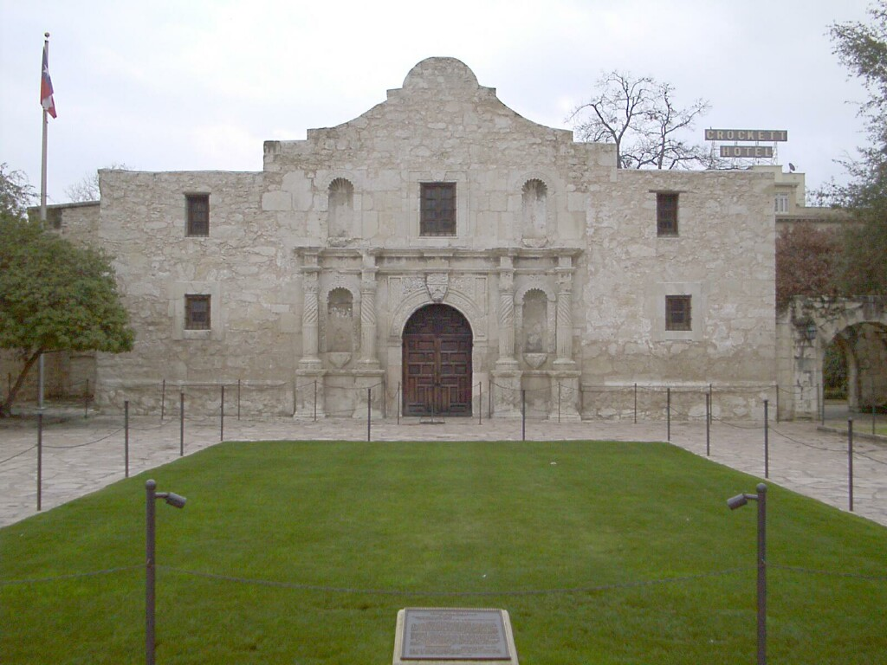

Slide 21
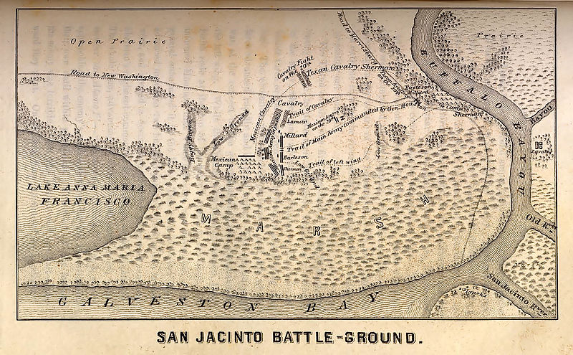
Battle of San Jacinto
SECTION 2
Santa Anna chased Texans under Sam Houston.
Texans took stand at San Jacinto River near Galveston Bay.
Houston’s forces attacked on April 21, 1836,
Mexican army was destroyed.
Santa Anna was captured
He was forced to sign treaty giving Texas independence

Slide 22
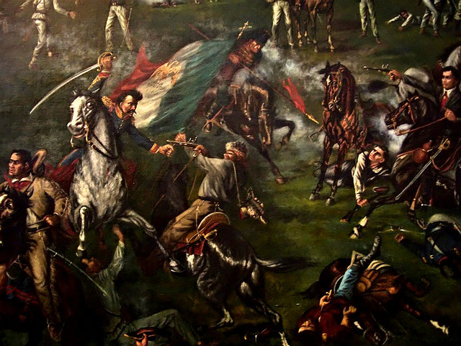

Slide 23
Independent Nation
SECTION 2
Sam Houston was the hero of the new independent nation of Texas and was elected president.
To increase population, Texas offered land grants to new settlers.
Most Texans hoped that the United States would annex, or take control of, Texas and make it a state.
President Jackson did not want to upset balance between slave and free states by letting a slave state enter the Union.

Slide 24
Section 3: Mexican-American War
Key Terms & People:
Manifest Destiny – belief that Americans had a God given duty to expand westward
James K. Polk –
Vaqueros – Mexican Cowboys
Californios – Mexican settlers in California
Bear Flag Revolt – Americans declared California an Independence from the Californios
Treaty of Guadalupe Hidalgo – Feb 1848 ended Mexican-American War, forced Mexico turn over its northern territories
Gasden Purchase – US paid Mexico $10 million for parts of AZ & NM fixed the present border with Mexico

Slide 25
Many Americans believed the nation had a manifest destiny to claim new lands in the West
SECTION 3
Americans believed they could build a new, better society founded on democratic principles.
The United States had a booming economy and population in the 1840s.
Needed more space for farms, ranches, businesses, and families.
Looked to the West.
Some believed it was America’s manifest destiny, or obvious fate, to settle all land to the Pacific.
Question was whether slavery would be allowed in new territories.

Slide 26
Acquiring New Territory
SECTION 3
Democrat James K. Polk elected in 1844; favored acquiring Texas and Oregon.
Oregon
Polk avoided war with Britain over Oregon and negotiated treaty for land south of forty-ninth parallel.
Oregon organized as territory in 1848.
Texas
Texas was annexed (added on) in 1845, but this action angered Mexico.

Slide 27
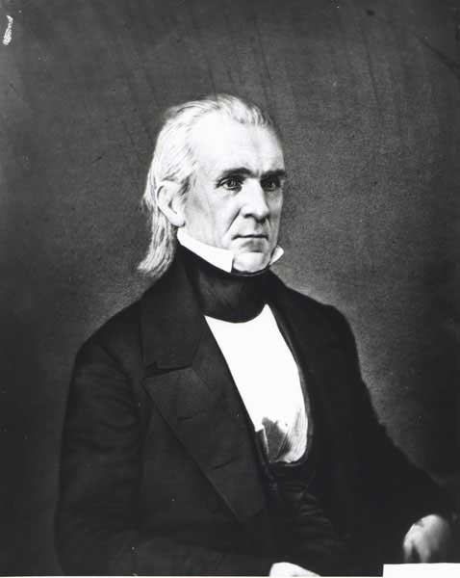
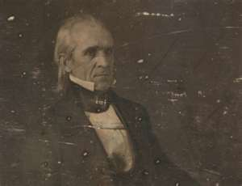

Slide 28
California under Mexico
SECTION 3
Mexico had lost Texas but controlled other areas in the present-day Southwest—New Mexico, Arizona, Nevada, and California.
The mission system was important in California, carrying out huge farming and ranching operations.
Missions were broken up in the 1830s by Mexico.
Land grants given to wealthiest California settlers
Created huge ranches
Worked by cowboys
Settlers from the United States started to arrive in small numbers. They began calling for independence.

Slide 29
Mexican-American War
SECTION 3
Conflict Breaks Out
The United States and Mexico were engaged in border disputes.
John Slidell went to Mexico to try to buy New Mexico and California for $30 million. Mexican officials refused to speak to him.
Polk ordered General Zachary Taylor and his army into the border region around the Rio Grande in 1846.
U.S. troops clashed with Mexicans in April.
War Begins
Congress declared war on Mexico in April.
Taylor’s forces won battles south of the Rio Grande.
General Stephen Kearny seized control of New Mexico.

Slide 31
Bear Flag Revolt
SECTION 3
Settlers
Revolt
John C.
Frémont
U.S.
Forces
Only about 500 Americans were in California in 1846.
Americans seized Sonoma and declared California to be an independent nation on June 14, starting the Bear Flag Revolt.
Frémont, leader of a U.S. Army mapping expedition, entered California to support its independence.
U.S. naval and military forces invaded California in June 1846 and claimed California for the United States.

Slide 32
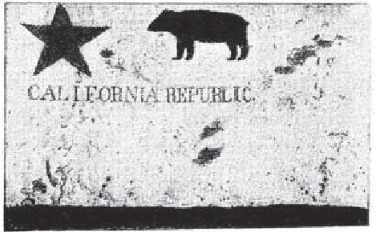

Slide 33
War’s End
SECTION 3
Buena Vista
General Taylor’s forces defeated the Mexican army under Santa Anna at Buena Vista in February 1847.
The Mexican army had fled overnight.
It was a fierce battle with heavy casualties on both sides.
Veracruz
General Winfield Scott’s forces seized the port of Veracruz in March 1847.
Veracruz was the strongest fortress in Mexico.
Mexico City
Scott’s troops took Mexico City in September 1847 after a brave defense by Mexican soldiers.

Slide 34
As a result of the Mexican-American War, the United States added territory in the Southwest
SECTION 3
Treaty of Guadalupe Hidalgo officially ended the war in 1848
Mexican Cession included present-day California, Nevada, Utah, parts of Arizona, New Mexico, Colorado, and Wyoming
Also included area claimed by Texas north of Rio Grande
Increased size of United States by almost 25 percent
Notes:
HI HI

Slide 36
Gadsden Purchase
In the Gadsden Purchase of 1853, the United States paid $10 million for southern parts of present-day Arizona and New Mexico.

Slide 37
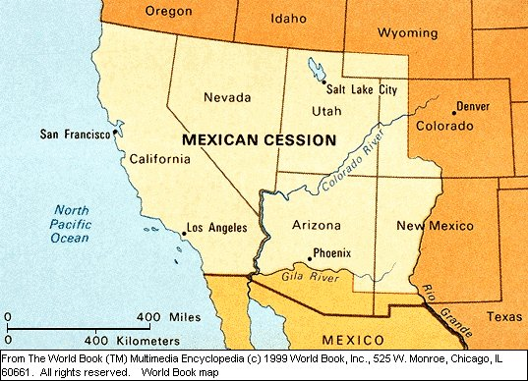
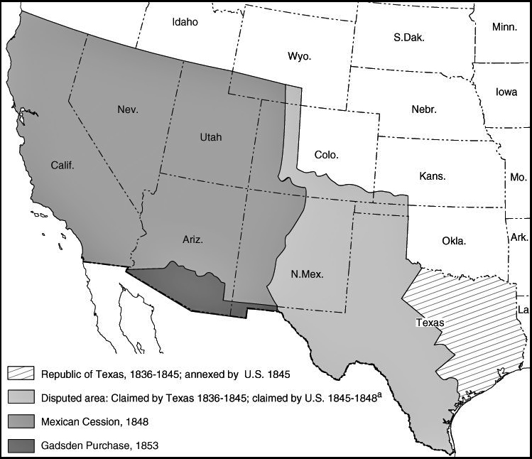

Slide 38
American settlement in the Mexican Cession produced conflict and a blending of cultures
SECTION 3
Surge of American Settlers
Americans flooded into the Southwest.
New settlers battled longtime residents to control land, water, and minerals.
Most Mexicans, Mexican Americans, and Native Americans faced legal, economic, and social discrimination from settlers.
Cultural Encounters
Different cultures shaped one another in the Southwest despite conflicts.
Names of places showed Hispanic and Native American heritage.
Mexican and Native American knowledge and traditions also shaped many local economies.

Slide 39
Section 4: California Gold Rush
Key Terms & People:
John Sutter – 1839 first gold strike found on his land Donner Party – settlers stranded in the Sierra Nevadas who had to resort to canabalism to survive
Forty-niners – gold seeking migrants in California
Prospect – to search for gold
placer miners – prospectors who panned for gold in rivers and streams

Slide 40
The discovery of gold brought settlers to California
SECTION 4
California controlled by Mexico before Mexican-American War.
Population was mostly Mexicans and Native Americans.
Mexican officials gave Swiss immigrant John Sutter permission to found a colony there in 1839.
Became a popular rest stop for immigrants.

Slide 41
Gold in California
SECTION 4
Gold was discovered at Sutter’s Mill in January 1848.
About 80,000 gold-seekers came to California in 1849; they were called forty-niners.
They would prospect, or search for gold, along banks of streams or in surface mines.
Placer miners used pans to wash gold nuggets out of loose rock and gravel.
California produced $60 million in gold in 1853.

Slide 42
Life in the Mining Camps
SECTION 4
Mining camps sprang up wherever enough people gathered to look for gold.
Miners came from many cultures and backgrounds.
Most were young, unmarried men in search of adventure.
80% were Americans; the rest came from around the world.
Only 5 percent of gold-rush immigrants were women or children.
Women generally made good money by cooking meals, washing clothes, and operating boardinghouses.
Miners paid high prices for basic necessities because the huge amount of gold in circulation caused severe inflation in California.

Slide 43
Westward Movement in the United States
SECTION 4
Causes
Americans believe in idea of manifest destiny
United States acquires vast new lands in West
Pathfinders open trails to new territories
Gold is discovered in California
Effects
Native Americans are forced off lands
Americans travel west to settle new areas
United States stretches to Pacific
California experiences population boom

Slide 44
Immigrants to California
SECTION 4
The lure of gold attracted miners from around the world.
Many Chinese men came in hopes of making great wealth and then returning to China—about 24,000 from 1849 to 1853.
Many Americans did not welcome the Chinese, but the Chinese still worked in gold mines, opened their own businesses, and held other jobs.
In 1853, California placed a high monthly tax on foreign miners.
The legal system favored Americans over immigrants.
In 1849 alone, about 20,000 immigrants arrived in California from China, Europe, Mexico, and South America.

Slide 45
The gold rush had a lasting impact on California’s population and economy
SECTION 4
Population Boom
Population explosion quickly made California eligible for statehood.
Became 31st state in 1850.
Economic Growth
New businesses and industries transformed California.
Completion of transcontinental railroad in 1869 ended isolation from rest of country and aided economy.

Slide 46
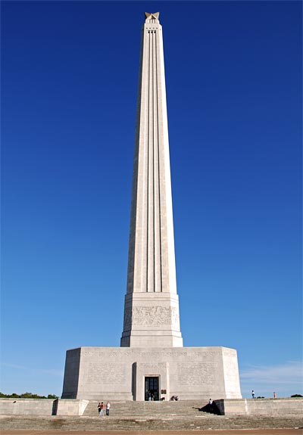
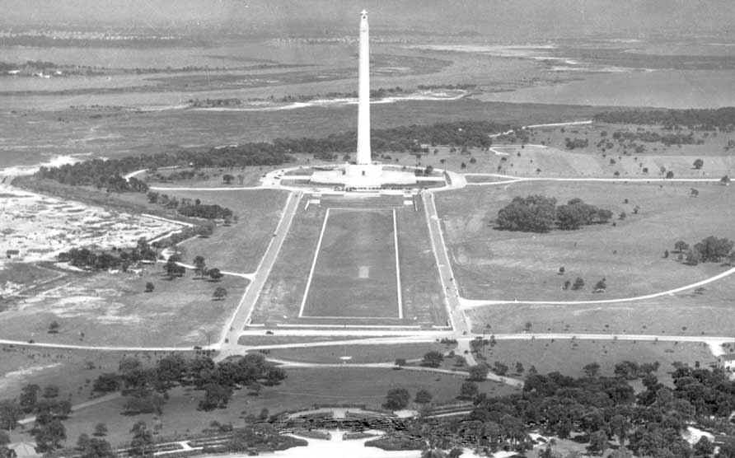
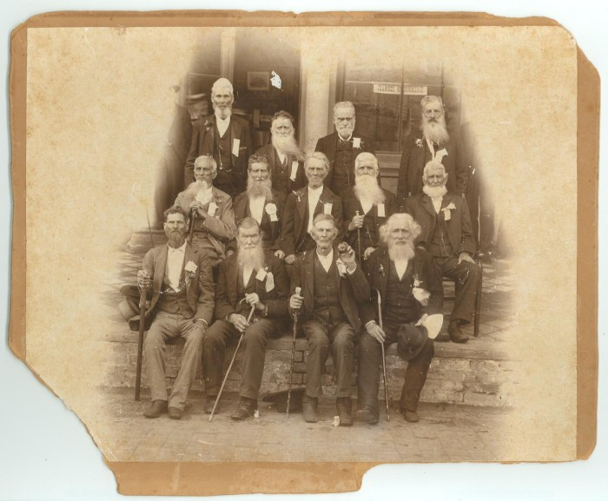
SECTION 2
Notes:
Veterans of battle of San jacinto & monument

Slide 47
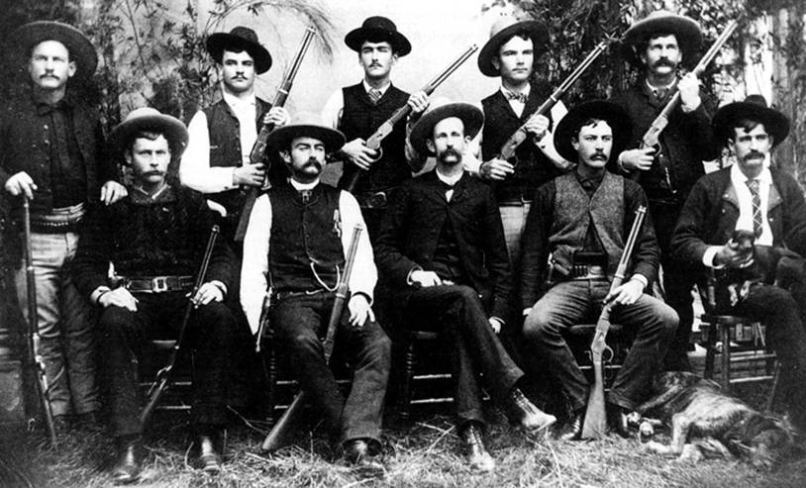
Texas Rangers
SECTION 2

