Slide 1
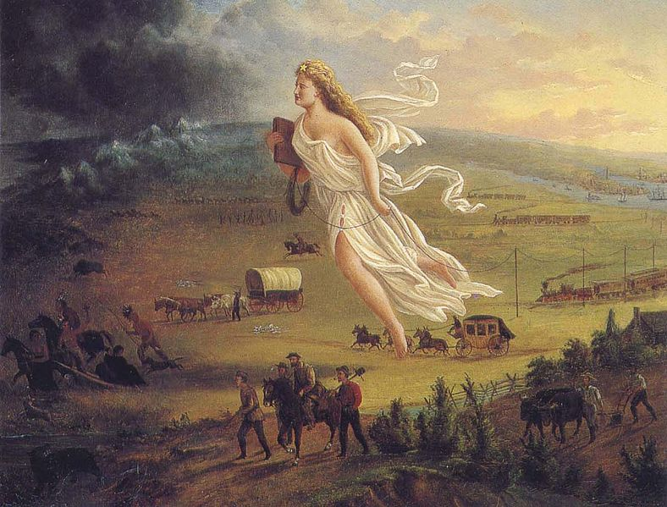
American Progress
By Jon Gast circa 1873
Symbols of Manifest Destiny
Name_____________________ HR_________

